Slide 1
Moshe Vardi and Intel Corporation: Long and Fruitful Collaboration
Eli Singerman¹, Gila Kamhi¹, Avner Landver¹, and Ranan Fraer²
1: Intel Corporation, 2: Cadence Design Systems
VardiFest, August 2022

Slide 2
1997-2022+

Slide 3
Formal Specification Languages
Moshe’s had a significant contribution to the definition of the Intel hardware specification language The ForSpec Temporal Logic: A New Temporal Property-Specification Language -- 2002
This language was used in Intel’s first formal verification frameworks and was later-on one of the seeds for today’s industry standard System Verilog Assertions (SVA) -- 2005
In addition, Moshe helped us in defining protocol/flow specification formalisms for modeling hardware and firmware system-level interaction -- From visual to logical formalisms for SoC validation -- 2014

Slide 4
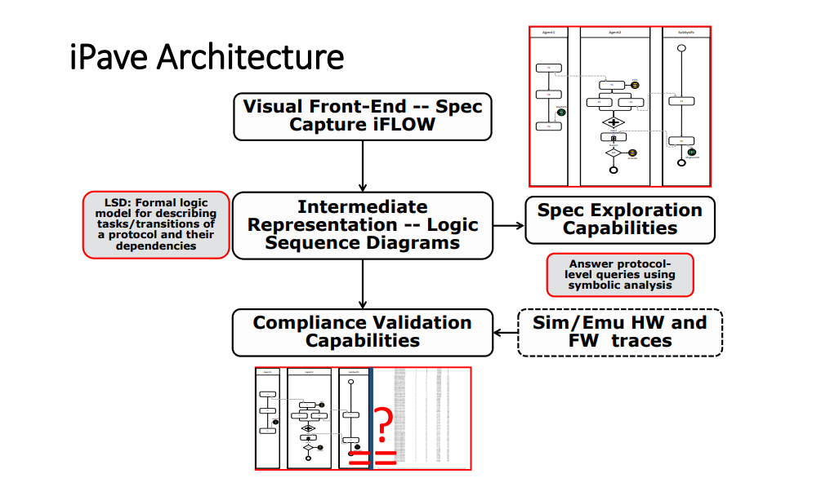
System Architecture

Slide 5
Formal Verification of Hardware
In 1995, Intel was one of the first companies to adopt formal verification
We started with academic tools like SMV, then transitioned to in-house development by a growing R&D team
Moshe played a key role in this transition, by guiding our research and pushing the boundaries of model checking technologies
Once Moshe connected us to the SAT community, Intel was among the first companies to develop a SAT-based model checker and confirm its success on industrial testcases. Benefits of Bounded Model Checking at Industrial Setting 2001

Slide 6
Formal Verification of Firmware and Hardware/Firmware Interaction
Moshe helped us in the first firmware/software formal verification framework we developed at Intel for Microcode. Formal verification of backward compatibility of microcode – 2005
At the time, it was one of the first examples of formal verification of firmware at industrial scale
A Temporal Language for SystemC – 2008
Validation of SoC Firmware-Hardware Flows: Challenges and Solution Directions - 2014
Some of our current work in formal methods for FW verification, is also influenced by Moshe’s contribution and insights

Slide 7
Last-but-not-least…
Moshe acted as a career coach, reliable professional friend to all of us as we grew in our career ladder and assumed several roles outside formal verification domain. Moshe has been our go-to-person as we moved to other challenges.
Thank you, Moshe, for your professional contribution; but above all for the person you are – always there for us – as a reliable friend and mentor!

